Slide 1

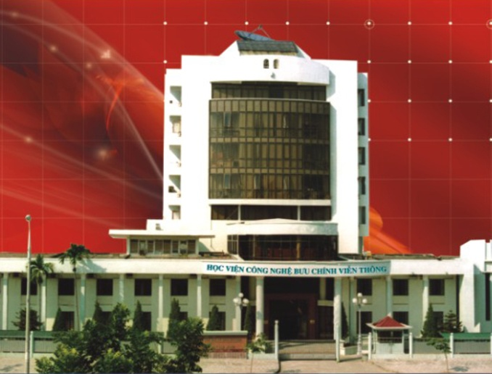
HỌC VIỆN CÔNG NGHỆ BƯU CHÍNH VIỄN THÔNG
COMPUTER ARCHITECTURE
I/O INTERFACING METHODS
Instructor: Associate Professor Phạm Văn Cường
E-mail: cuongpham.ptit@gmail.com
www: https://sites.google.com/view/cuongpham/home

Slide 2
Content
Introduction
Polling
Interrupt
Direct Memory Access

Slide 3
Introduction
Why I/O:
Interfacing between CPU and other devices
Providing data stream for CPU
Providing sevices for CPU outputting data
methods:
polling
Interrupt
DMA-Direct Memory Access

Slide 4
Ports
PS/2: for keybooard and mouse
COM: serial port
LPT: parallel port
IDE, SATA, SCSI: for hard drives
LAN: for local network card
Audio: for speaker, mic vnd line-in
Video: for monitor
DVI : for digital monitor
USB:
USB 1.0: 12Mb/s
USB 2.0: 480Mb/s
USB 3.0: 1.5Gb/s

Slide 5
Polling
CPU manages devices and port addresses;
CPU scans devices for checking if they are ready:
If one device is ready, data are exchanged;
CPU is controlling during data exchange process

Slide 6
Polling
Advantages:
Simple, easy to deploy
Can be programmable
Disadvantages:
Low-effectiveness as time-consuming for polling
Non-feasible for too many devices
Applications:
System starting up: CPU checks device for configurations
New devices plugged into the system

Slide 7
Non-priority polling
Three devices A, B, C
CPU scans all devices in a polling cycle
CPU can exchange one more devices within a polling cycle
Devices are scanned one by one.
Start
A Ready?
Yes
Exchange data with A
No
B Ready?
Yes
Exchange data with B
No
C Ready?
Yes
Exchange data with C
No

Slide 8
priority polling
Three devices A, B, C in order of priority A, B, C;
CPU can scan all devices in a polling cycle
CPU can only exchange data at most one device within a polling cycle
Device with high priority is firstly scanned
Start
A Ready?
Yes
Exchange data with A
No
B Ready?
Yes
Exchange data with B
No
C Ready?
Yes
Exchange data with C
No

Slide 9
Interrupt
What is an interrupt?
Interrupt is an event that CPU temporary stops an executing program in order to execute another one for a request (so-called interrupt request) from I/O;
The program runs while CPU interrupted call interrupt sub routine (ISR).
ISRs are stored on ROM and are often used for I/O or controlling I/O devices

Slide 10
Interrupt vector table (IVT)
8086/8088 has 256 interrupts numbered from 0 to 255
An interrupt vector consists of:
A number of N, N=0-255 hoặc 00-FFH
An address of ISR in ROM:
Code segment (CS)
Instruction Pointer (IP)
IVT stores the information of all 256 interrupt vectors.

Slide 11
Interrupt vector table
Bảng vector ngắt
ROM
FF
Bắt đầu CTCPVN
01
IP
Bắt đầu đoạn
CS
00
IP
CS

Slide 12
Interrupt response of CPU
CTC
CTCPVN
CODE
CPU:
Store shared resgisters
pust FR
disable IF and TF
push CS and IP
get the interrupt route address from IVT
Interrupt request
Temporary terminates
CTCPVN code
continue CTC
CPU:
pop IP and CS
pop FR
enable IF and TF
Restore shared registers
IRET
Notes:
D08.1 13.10

Slide 13
Interrupts
Advantages
More effective than polling
Disadvantages
More complicated than polling
Need more hardware
CPU is subjective to control I/O:

Slide 14
Direct Memory Access- DMA
CPU handles over for I/O by polling and interrupt.
DMA (Direct Memory Access) allows exchange data between memory and I/O without CPU;
DMA can be suitable for large data size exchanged in short time.
Memory
CPU
I/O
Polling and interrupt
Memory
CPU
DMAC
I/O
DMA

Slide 15
Direct Memory Access- DMA
DMAC (DMA Controller) takes over CPU for controlling data exchanged between I/O and memory;
DMA is much higher speedy than polling and interrupt. Example (8088):
It does take 4 clock cycles to transfer 1 byte from I/O to memory for DMA;
With the same task, it takes up to 39 clock cycles for the use of CPU to exchange data:
; clock cycles
LAP: MOV AL, [SI]; 10
OUT PORT, AL; 10
INC SI; 2
LOOP LAP; 17
; Sum: 39 clock cycles

Slide 16
Direct Memory Access- DMA
Memory
System Bus
CPU
HOLD
DRQ
DMAC
I/O
HLDA
DACK
Notes:
D08.2,3 13.10

Slide 17
Direct Memory Access- DMA
Advantages:
Effective as data are exchanged in blocks (without CPU);
Disadvantages:
More complicated than polling and interrupt;
Need hardware (DMAC)
subjective: I/O

